Slide 1

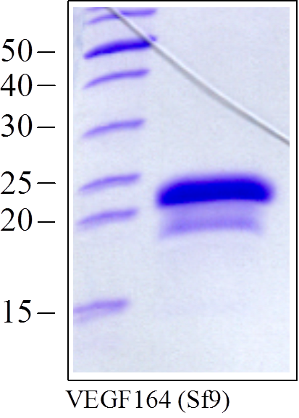
ReliaTech GmbH
Recombinant human VEGF164
(Cat #M30-001 / M30-002)
Fig. 1: SDS-PAGE analysis of recombinant mouse VEGF₁₆₄ produced in insect cells. Sample was loaded in 15% SDS-polyacrylamide gel under reducing conditions and stained with Coomassie blue.
http://www.reliatech.de / orders@reliatech.de

